Slide 1
CUSTOMER RECOMMENDATION SYSTEM
By,
TEAM: TECHHEARTS
1. ThiruKkumaran V
2. Faizan R
3. Aishwarya S

Slide 2
CUSTOMER RECOMMENDATION SYSTEM
Introduction on Customer Recommendation System
Existing Approach
Face detection Approach
Demo
Conclusion

Slide 3
Introduction - Customer Recommendation System
Recommending the necessary suitable product based on the previously purchased history.
One of the easiest way to reduce the shopping time in supermarkets.

Slide 4
Existing Approach
Data mining Techniques:
The data mining techniques include classification, clustering, association rules, regression analysis, sequence analysis, rule-based reasoning approach, genetic algorithms, decision trees, fuzzy logic, inductive learning systems, and statistical methods.
Memory-based collaborative filtering:
The CF algorithms are popular techniques for E-Systems. It involves the user-item database to predict which items users really like. According to every user who belongs to a group of people with similarity interests, we can find a group of people who share similar interests. By doing so, we can recommend the item to a user by it. In fact, it is neighborhood-based recommendation system and very prevalent.

Slide 5
Face detection approach
Capture the customer face through the web camera
Train the captured image data using SVM algorithm
If the customer visits the shop again, it deducts the customer face feature and compare with the trained image data.
Then it return the matched customer id from the customer database. we can get the customer previous purchasing details.
With that purchased details, we can recommend them new offers, new arrivals related to that product.

Slide 6
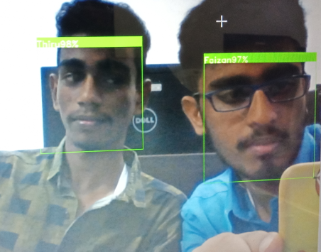
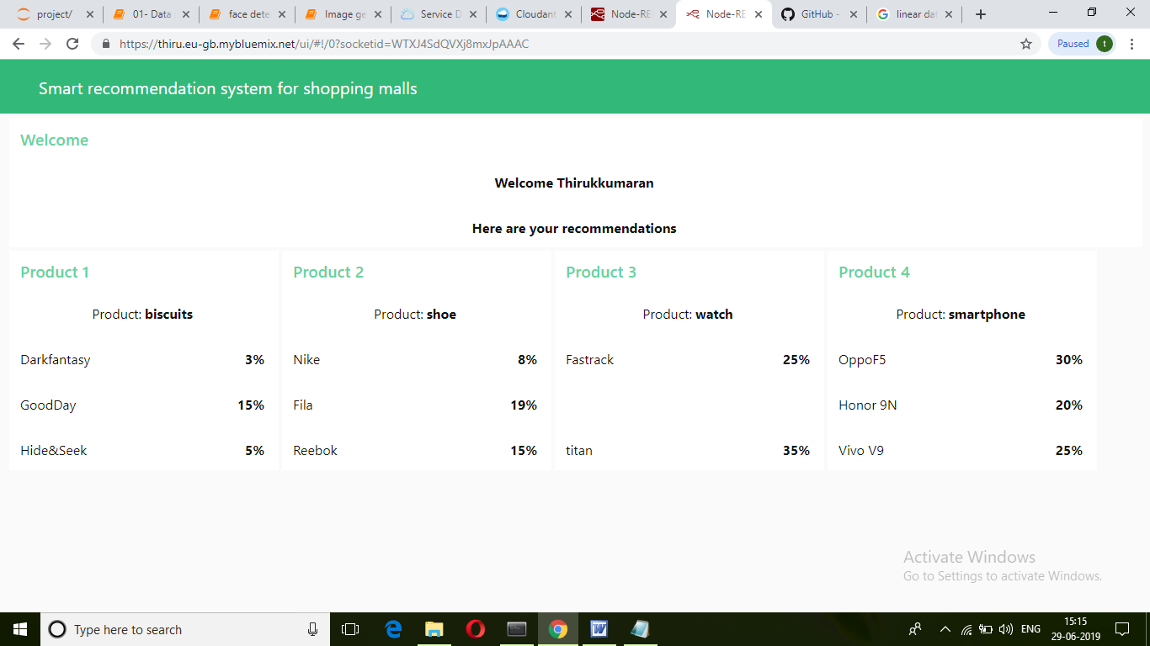
DEMO

Slide 7
Conclusion
Product recommendations to a particular user preferences creates a positive effect on sales revenues and user experience.
An idea towards the growth of technology.

